Slide 1
Lecture 2
Viscosity
Measurement of viscosity
Rheochor
Refractive Index
Measurement of refractive index
Specific and molar refractivity

Slide 2
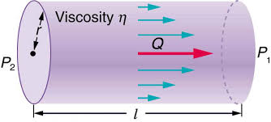
Viscosity
The resistance that one part of the liquid moving with one velocity offers to another part of liquid moving with another velocity is known as viscosity.

Slide 3
If “S” is the area of interface between two liquid layers,
“dx” is the distance between layers
“dv” is the difference in velocity of layers.
Then the force required to maintain a constant velocity difference is
F ἀ S.dv/dx and
F = ɳ S.dv/dx

Slide 4
dv/dx is called velocity gradient and ɳ is called coefficient of viscosity.
ɳ = F.dx/ S.dv
ɳ is “force per unit area required to maintain unit difference of velocity between two layers in the liquid unit distance apart at a given temperature”

Slide 5
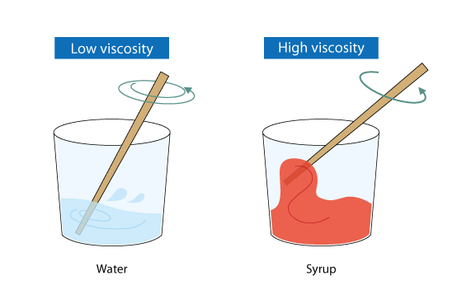
Units
In CGS system
g cm⁻¹ s⁻¹ or dyne cm⁻² s or Poise
In SI system
Kg m⁻¹ s⁻¹

Slide 6
Measurement of Viscosity
Poiseuille Equation
ɳ = π P r⁴ t/ 8L V
“V” volume of liquid flowing in time “t” through capillary tube of radius “r” and length “L” under a constant driving pressure “P”.

Slide 7
If ɳ₁ and ɳ₂ are the coefficient of viscosity of two liquids with densities d₁ and d₂ and their time of flow is t₁ and t₂,
Then, ɳ₁ = π P₁ r⁴ t₁/ 8L V---------1
ɳ₂ = π P₂ r⁴ t₂/ 8L V----------2
P₁ and P₂ are the pressures on two liquids.

Slide 8
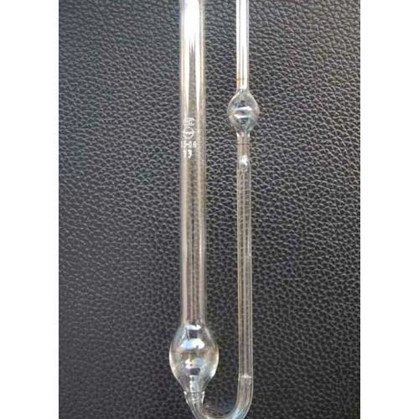
ɳ_{1 /} ɳ₂ = P₁ t₁/ P₂ t₂ ---------3
As, P ἀ d (Pressure is directly proportional to density)
so,
ɳ_{1 /} ɳ₂ = d₁ t₁/ d₂ t₂ ---------4

Slide 9
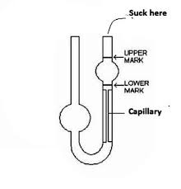
The time of flow can be easily measured by viscometer.
The liquid whose viscosity is to be determined is taken in C.
It is then drawn into A by suction upto mark X.
Now, time is measured when liquid travels from X to Y, by stop watch.
Then, viscometer is cleaned and whole process is repeated with other liquid .
Knowing the d₁ , t₁ , d₂ ,t₂ and ɳ_{1,} values are put in the following equation to get ɳ₂.
ɳ_{1 /} ɳ₂ = d₁ t₁/ d₂ t₂
X
A
Y
B
C
Ostwald’s Viscometer

Slide 10
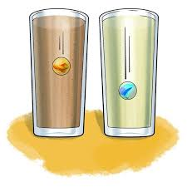
Race of marbles

Slide 11
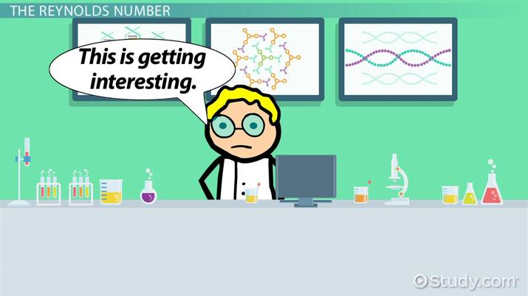

Slide 12
Numerical
The time of flow of water through an Ostwald viscometer is 1.52 min, for the same volume of an organic compound of density 0.80 g/cm⁻³, it is 2.25 min.
Find viscosity of the liquid relative to water and also absolute viscosity at 20ᵒ C. Density and viscosity of water is 1 g/cm⁻³ and 1.002 x 10⁻² poise.

Slide 13
Viscosity and chemical constitution
Dunsten (1909) determined a relationship between viscosity and inverse molar volume…
d/M x ɳ x 10⁶= 40 to 60
This relationship is only useful for non-associated liquids (normal).
For associated liquids the value of d/M x ɳ x 10⁶ is more than 60.

Slide 14
Molecular Viscosity
M/d is called molar volume.
[M/d]^{2/3} is surface area of 1 mole of liquid{Molar surafce}.
^{So} Molecular Viscosity is
Molecular viscosity = [M/d]^{2/3} x ɳ

Slide 15
Rheochor
Newton Friend expressed “the product of molar volume and the eight root of viscosity of a liquid at a particular temperature is constant and is called Rheochor.”
Rheochor R = [[M/d]^{1/8} x ɳ
Rheochor is the molar volume of a liquid at a temperature where its viscosity is ________?

Slide 16
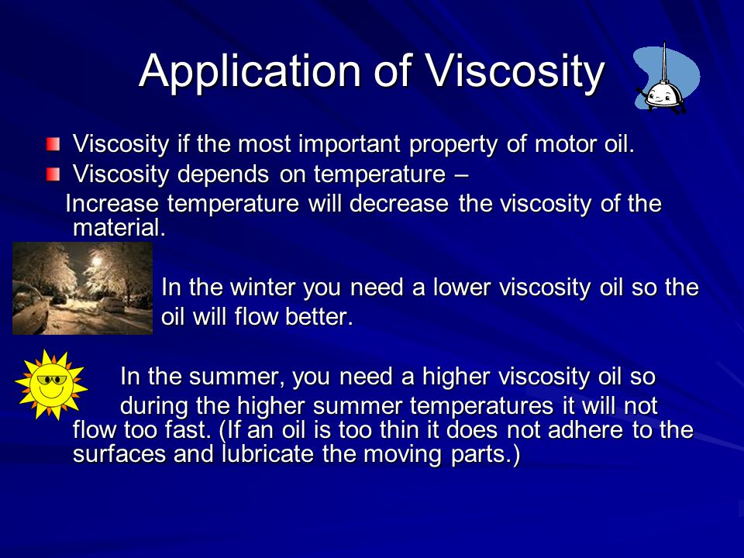

Slide 17
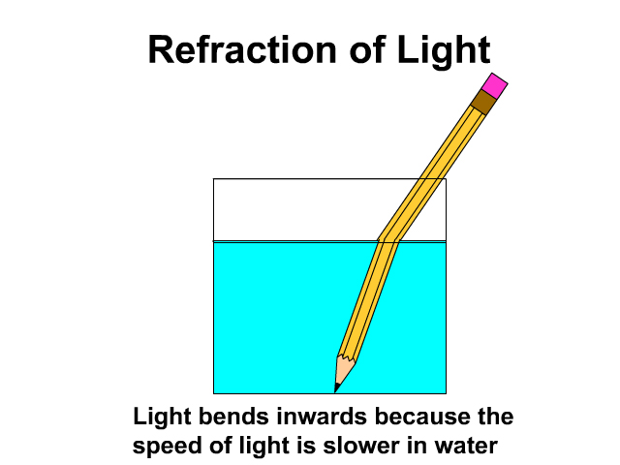
Refractive Index
Ratio of velocity light in air to the velocity of light in that medium is called refractive index.
What is refraction?

Slide 18
Snell’s law
n_{med} = sin i/sin r
According to wave theory
n_{med} = velocity of light in air/ velocity of light in liquid
When angle of incidence increases, angle of refraction also increases, when angle of incidene is 90ᵒ (Grazing Angle), angle of refraction reaches its maximum value and is called Critical angle.
n_{med} = 1 /sin r_{c}

Slide 19
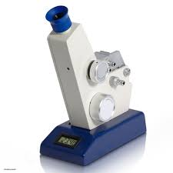
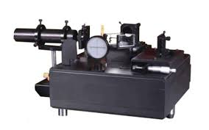
Measurement of refractive index
Refractometer
Interferometer

Slide 20
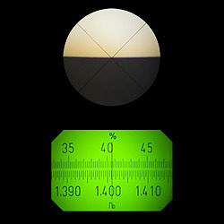
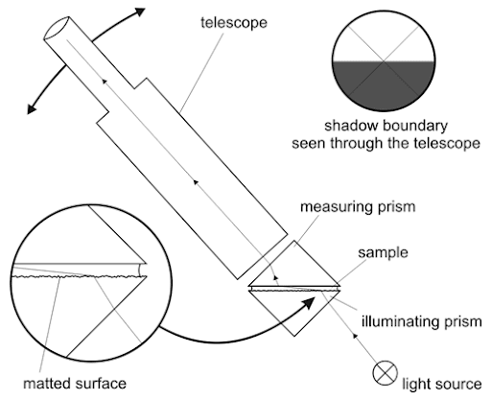
Abbe’s Refractometer

Slide 21
Specific Refraction
R = n²-1/n²+2 X 1/d
Molar Refraction
R_{M} = n²-1/n²+2 X M/d

Slide 22
Numerical
Refractive index of an organc compound is 1.5044.if its density is 872 kg m⁻³,calculate its molar refraction (M= 78)?

